Slide 1
Stage 1 - Getting Started
Getting Started
Scoping
Develop
Implement
Monitor and Evaluate
Follow-up

Slide 2
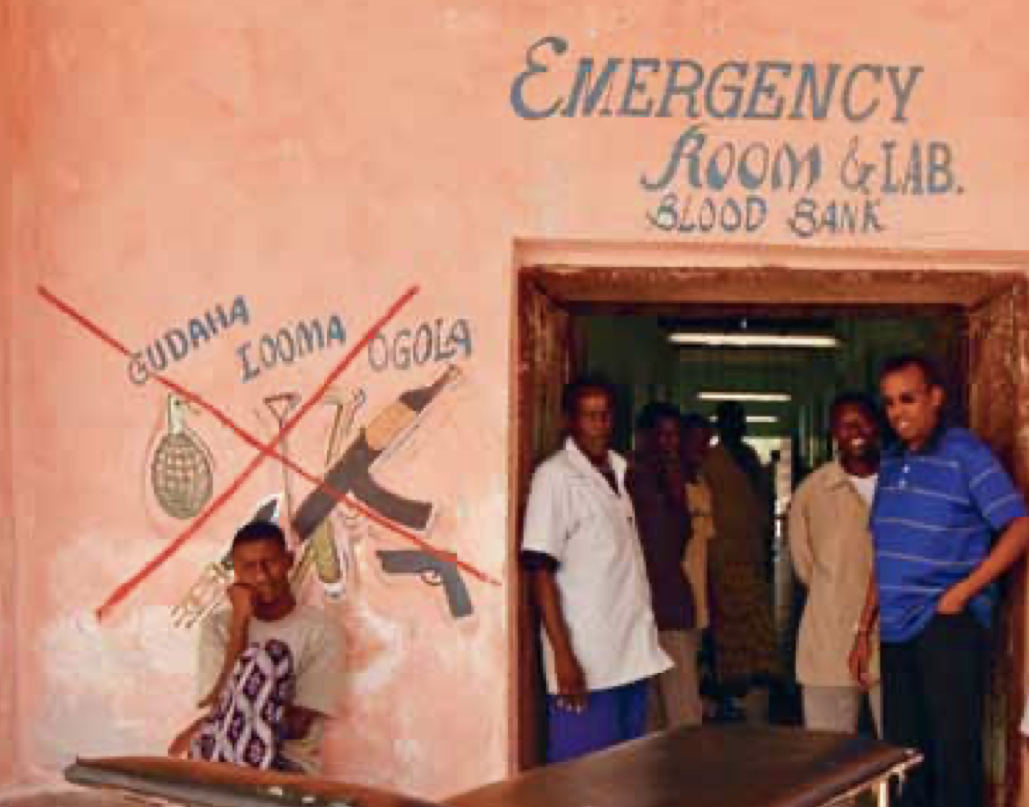
Contents of Getting Started
You will know if your problem can be helped with this tool
Engaging successfully with stakeholders
Carrying out simple risk assessments
What resources and partners do you have to help?

Slide 3
What is currently happening in the healthcare centre in terms of weapons
Making a case for action is really important and we have listed some of the key impacts of weapons and how this tool will help in a separate section Making the case
Before you start it is important to understand what this tool can help with. It is suitable for the reduction in the circulation of weapons in health facilities but it cannot stop premeditated attacks from arms carriers
Your first action should be to have some informal discussions internally within the health centre about who is bringing in weapons and what the impact is to ensure that you have a problem that can be helped by using this tool

Slide 4
Understanding who your key stakeholders and partners are
Understanding the people and organisations that can help you and those who could potentially stand in your way is very important.
A simple tool is available to do this and is shown on the next slide.
It helps you categorise your stakeholders and potential partners by influence and interest.
The higher the influence and interest the more you have to engage and consult with them.

Slide 5
Prioritising your stakeholders
THE GROUP OF ARMED CARRIERS BRINGING IN GUNS ARE KEY STAKEHOLDERS
For example if you were trying to get a protocol that would limit the weapons that a certain group of armed carriers were bringing into the hospital it is vitally important that you include them in the planning and development of an intervention

Slide 6
Risk Assessment
It is critical to understand the key risks and security of the healthcare facility.
The HCiD team have developed a fully comprehensive tool - a Security Survey for Health Facilities.
This tool may not be appropriate for your currents goals of intervening in the health facility, as it addresses a larger scope of risks and denotes a broader engagement of the ICRC with the vulnerabilities of that site. We have therefore a no weapons risk checklist that can be carried out quickly.
It should be noted that this simple checklist is not a replacement for the full security survey.

Slide 7
Getting Started
Finally it is important to understand what resources are available for the intervention.
There is no point in developing an intervention where you have no budget to implement.
It is important to be realistic but also to explore avenues for joint working with other government bodies, humanitarian organisations and local community groups.

Slide 8
By the end of Getting Started
By completing the work outlined in the previous slides you will know:
who your priority partners and stakeholders are and a simple plan of how you will engage with them over the development of your intervention.
what are the key physical and organisational risks facing the facility in terms of weapons infiltration.
What resources will be available to develop the intervention.

