Slide 1
Making the case for action on weapons in healthcare facilities

Slide 2
Making the case for action (1)
Making the case for action can be difficult because:
When weapons are everywhere and as there is acceptance of them in society it is difficult to prioritise action.
There are often higher priorities within the healthcare system
Most of the impacts of the infiltration of weapons are not immediate and difficult to quantify effectively.
The banning of weapons within healthcare facilities is often not required by legislation or law.
When legislation exists, it is often not enforced.
Because of the different population segments that are bringing weapons into health care facilities - civilians, police, armed groups - there is a perception among many people that the problem is too complex to deal with.

Slide 3
Making the case for action (2)
Making the case for action can be difficult because:
There is acceptance that the police and army will not stop bringing their weapons into healthcare facilities because:
They need the security of a weapon when they are escorting a prisoner
They fear the loss of the weapon
It is part of their uniform
There is insufficient information, guidance and support available on what works to reduce the infiltration of guns.
Projects may be delivered but are not monitored and evaluated effectively, meaning that there is no evidence base.
The rapid changeover of staff in humanitarian organisations means that knowledge of what works and why is often lost

Slide 4
The impact of weapons infiltration in healthcare facilities
The impacts of weapons infiltration are wide-ranging with both short-term and long-term negative outcomes.
It is critical that you understand the direct impacts on the healthcare facility you are working in, so you can make an effective case for action and develop an effective intervention.
Some of these key impacts are shown on the next slides.
We will show you how to understand the impact in your own health facility by carrying out some simple assessments.

Slide 5
Impact of weapons on medical care
When a firearm is discharged the facility may need to close down. Time is lost even when staff have to deal with a small-scale incursion of weapons.
Weapons are used by relatives to get treatment quickly which means people that need more urgent treatment are denied it.
When armed police/army visit a healthcare facility with a detainee they may come with other many armed officers that can cause disruption.
VIPs arrive with large-scale weaponed security units that cause delays in treatment.
The impact of an accidental discharge of a weapon within the healthcare facility can lead to harm or death.
Weapons in healthcare facilities can hinder clinical improvements such as better triaging.
Listen here to describe some of the impacts of the infiltration on medical care

Slide 6
Impact on healthcare workers
Where weapons are visible and armed there is the possibility of healthcare workers being harmed.
The impact on healthcare staff can be corrosive causing increases in stress leading to mental health problems and have long term impacts on patient care, sickness absence and staff turnover.
The impact of killings (gang, honour, criminal) by armed perpetrators on healthcare workers can be traumatic.
The impact of people using weapons to threaten healthcare workers to treat their family or friends leads to an escalation in the carrying of weapons.
Healthcare workers do not have the confidence or skills to confront or negotiate with weapon bearers leading to frustration and de-motivation.
Listen here to some of the impacts on healthcare workers

Slide 7
Impact on people using healthcare facilities
While weapons are visible and armed there is always the possibility that people using the facility can be harmed.
When the healthcare facility is perceived by people as unsafe it reduces the willingness of local people to use that facility.
When a healthcare facility is perceived as dangerous, many people will not attend for routine tests and screening.
It is often difficult to recruit professional staff into facilities that have weapons infiltration leading to a reduction in the types of treatment available.
The quality of care is severely reduced when weapons and violence against healthcare workers is endemic.
When people see weapons being worn by the police or army it can have a traumatic impact on people.
Listen here to hear the impact on people using the facilities

Slide 8
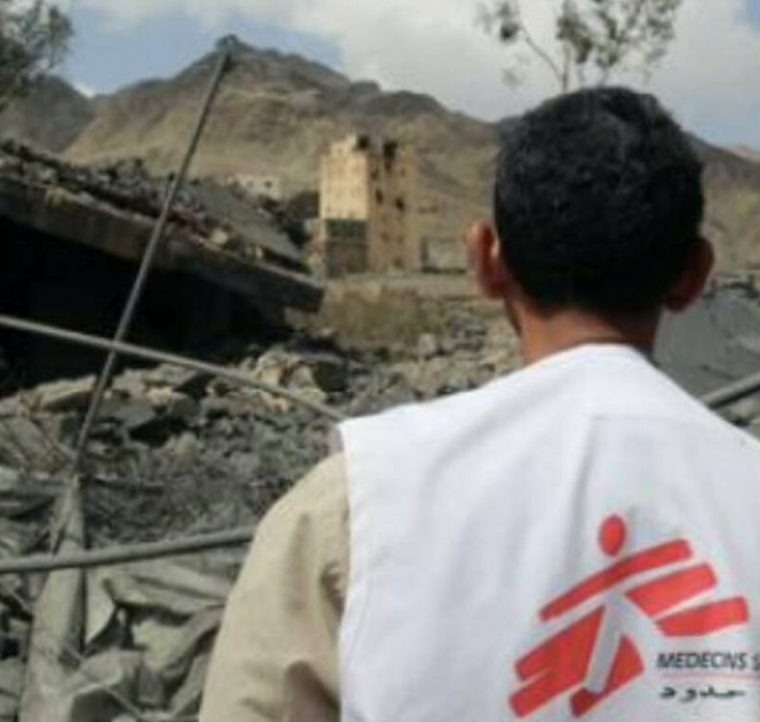
The loss of perception safe space
When healthcare facilities are seen to lose their neutral status because weapons are being used they can become targets for bomb strikes.
By allowing weapons into facilities they can become flashpoints for local tribal/armed group conflict causing gunfights within the establishment itself.

Slide 9
Why have we listed these difficulties?
It is possible that stakeholders and partners will use these arguments to stop you taking action.‘It’s all too difficult and complex” and “there is no evidence to support activity in this area”
However, by using the planning process many of the difficulties we have listed can be overcome.
This tool will provide you with tangible evidence that allows you to prioritise action
We will show you how to quantify the impact of weapons
The tool will show you practical examples of mechanisms that have been used to change peoples behaviours
Our tool is constantly updating and includes new case studies

